Slide 1
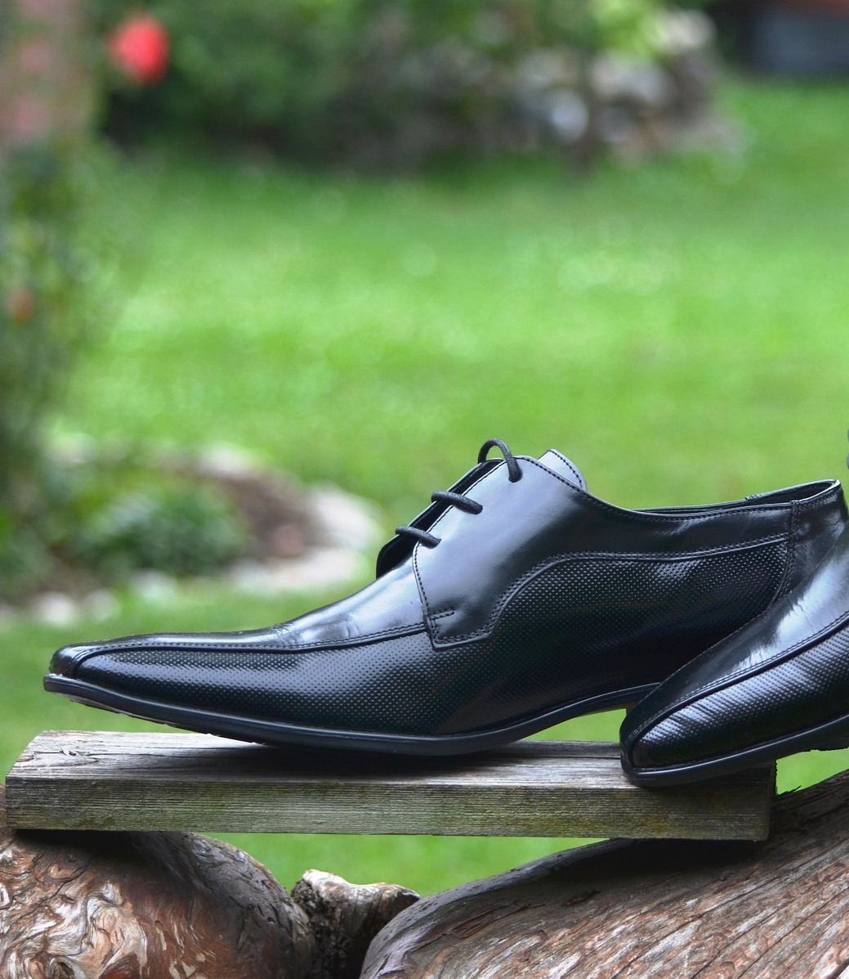
AUTOMATED SHOE
POLISH MACHINE
Group 12
INDIVIDUAL CONTRIBITION – RANASINGHA R.A.A.T – 205082T
IS 1900 BUISNESS PROJECT

Slide 2
RANASINGHA R.A.A.T
205082T
Ultrasonic Sensor Gear Motor

Slide 3
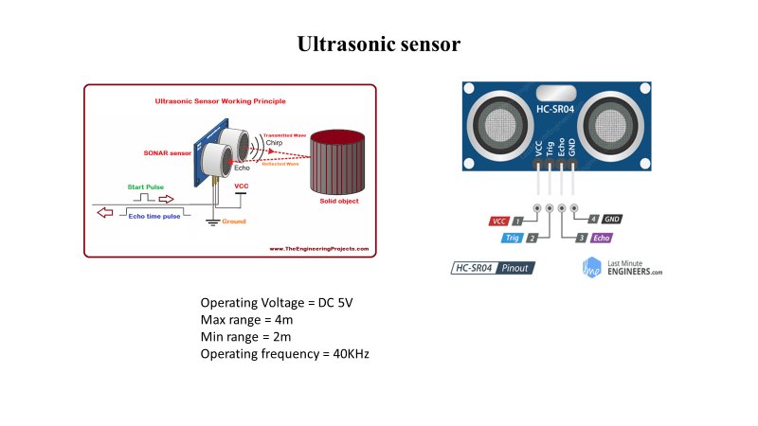

Slide 4
HEADER FILE
#ifndef ULTRASONIC_DISTANCE_H_
#define ULTRASONIC_DISTANCE_H_
#define US_PORT PORTD
#defineUS_PINPIND
#define US_DDR DDRD
#define US_ERROR-1
#defineUS_NO_OBSTACLE-2
int distance;
char numberString[4];
void HCSR04Init(uint8_t trig)
{US_DDR|=(1<<trig);
}void HCSR04Trigger(uint8_t trig)
{US_PORT|=(1<<trig);//high
_delay_us(15);//wait 15uS
US_PORT&=~(1<<trig);//low
}int16_t GetPulseWidth(uint8_t pos){
uint32_t i,result;{
if(!(US_PIN & (1<<pos)))

Slide 5
continue;//Line is still low, so wait
else
break;//High edge detected, so break.}
if(i==600000)
return US_ERROR;
TCCR1A=0X00;
TCCR1B=(1<<CS11); TCNT1=0x00;
for(i=0;i<600000;i++) {
if(US_PIN & (1<<pos))
{if(TCNT1 > 60000) break; else continue;}
else
break;}
if(i==600000)
return US_NO_OBSTACLE;//Indicates time out

Slide 6
d1 = GetPulseWidth(PD1);
HCSR04Init(PD2);
HCSR04Trigger(PD2);
d2 = GetPulseWidth(PD3);
if(d1 == US_ERROR || d2 == US_ERROR)
{lcd_cmd(0x80);
lcd_str("!");}
else
{if (d1 == d2){
distance=d1;
distance=distance*0.034/2.0 + 1;}
if (d1>d2){
d1=d1*0.034/2.0 + 1;
distance=d1;
}else{
d2=d2*0.034/2.0 + 1;
distance=d2;}}
return distance;}
#endif /* ULTRASONIC_DISTANCE_H_ */

Slide 7
#include <avr/io.h>
#define F_CPU 16000000UL
#include <util/delay.h>
#include <stdio.h>
#include <avr/interrupt.h>
#include "lcd_ce.h"
#include "ultrasonic.h"
int main()
{
lcd_init();
char numberString[4];
uint16_t d1, d2; int distance, previous_distance = 0;
_delay_ms(100);
while (1)
{HCSR04Init(PD0);
HCSR04Trigger(PD0);
d1 = GetPulseWidth(PD1);
HCSR04Init(PD2);
HCSR04Trigger(PD2);
d2 = GetPulseWidth(PD3);
if(d1 == US_ERROR || d2 == US_ERROR {
lcd_cmd(0x80);
lcd_str("Error!");
}else
{
distance = (d1 > d2)? ((d1 - d2)*0.034/2.0 + 1) : ((d2 - d1)*0.034/2.0 + 1);
COMPILE CODE

Slide 8
if (distance != previous_distance)
{
lcd_clear();
lcd_cmd(0x80);
itoa(distance, numberString, 10);
lcd_str(numberString);
lcd_str(" cm");
previous_distance = distance;
}
_delay_ms(30);
}}
return 0;
}

Slide 9
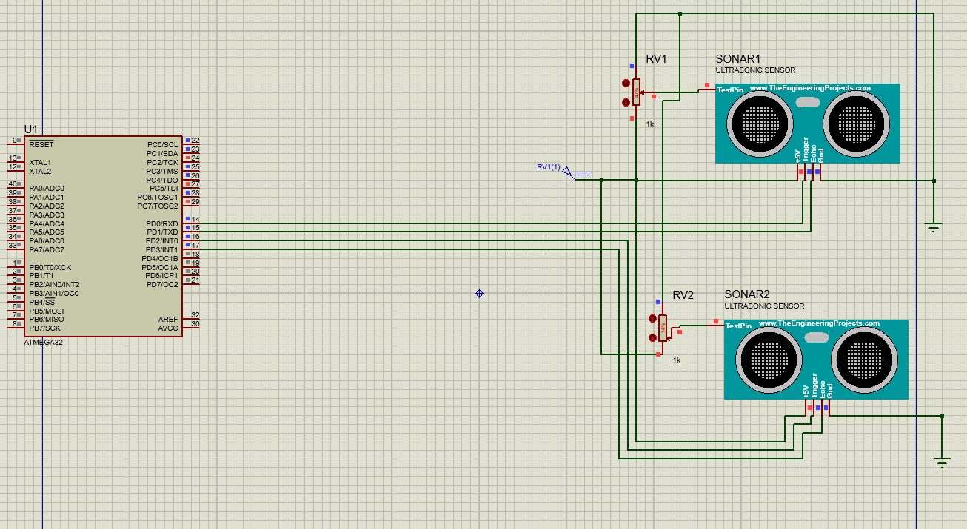
Circuit Diagram for Ultrasonic sensor

Slide 10
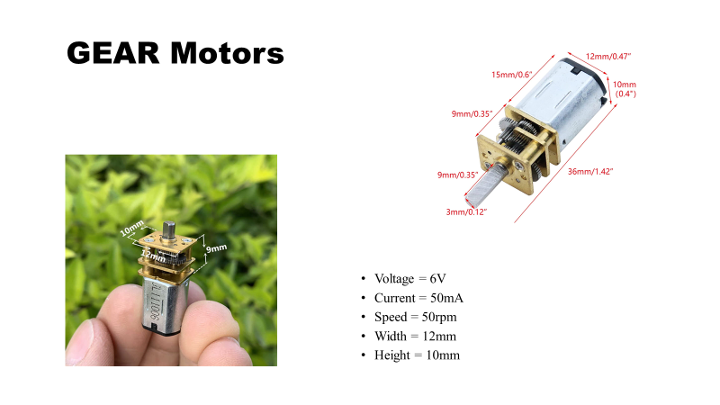

Slide 11
Compile Code
#define F_CPU 1000000UL
#include <avr/io.h>
#include <util/delay.h>
int main(void)
{DDRD |= (15<<4);//make portD 4-7 pins as output
while(1){
unsigned int d=3000;
//clock wise
PORTD|=(1<<4);//motor 1 on
_delay_ms(d);
PORTD&=~(1<<4);//motor 1 off
_delay_ms(d);
PORTD|=(1<<6);//motor 2 on
_delay_ms(d);
PORTD&=~(1<<6);//motor 2 off

Slide 12
_delay_ms(d);
//anti clock
PORTD|=(1<<5);//motor 1 on
_delay_ms(d);
PORTD&=~(1<<5);//motor 1 off
_delay_ms(d);
PORTD|=(1<<7);//motor 2 on
_delay_ms(d);
PORTD&=~(1<<7);//motor 2 off
_delay_ms(d);
}
}

Slide 13
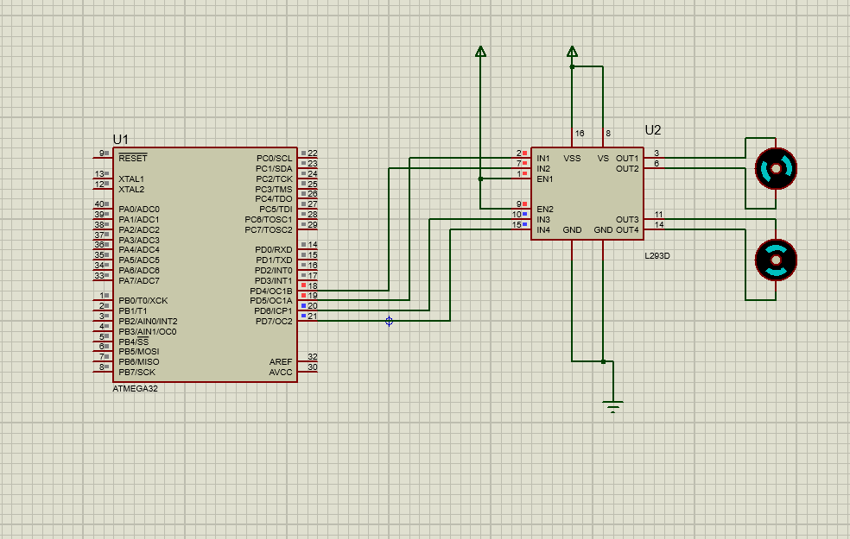
Circuit Diagram for Gear motor

